Slide 1


Hotspot JVM’s
Deadlock Detection
Presented by team Red:
Nicolas Ohannesian
Alexa Dye
Thu Lam
Sapir Avrahami

Slide 2
The Hotspot JVM
Utilized by both Oracle’s Java and OpenJDK
Has built-in (but limited) deadlock detection capabilities
Ctrl+Break handler executes a deadlock detection algorithm
Prints information about deadlocked threads after the thread dump

Slide 3
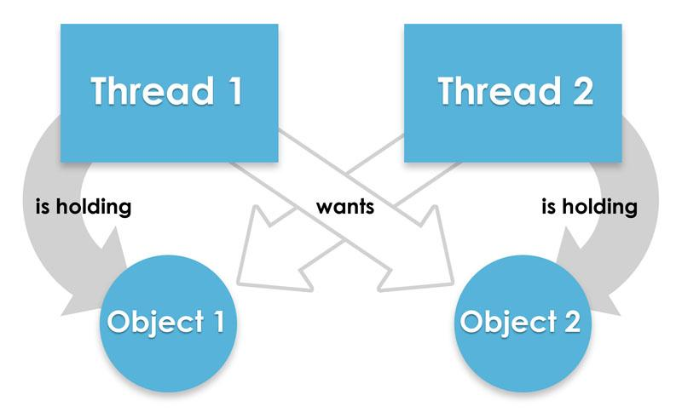
What Exactly are Deadlocks?

Slide 4

Example Deadlocks Found
Caught by HotSpot:
A. Basic Shared Resource deadlock (on 2 or 3 resources):
Shared resource
Acquire lock on the first object
When trying to acquire lock on second object → goes on wait state because it’s already locked by another thread.
→ forming a cyclic dependency for resource between Threads
→ causing deadlock.
B. ReentrantLock deadlock (Wait - Notify):
Object will be replaced by a ReentrantLock object
Run the same way

Slide 5
Weaknesses
Deadlocks NOT Caught by HotSpot:
ReentrantReadWriteLock: Java HotSpot has a problem with detecting READ deadlocks.
Aliasing Deadlocks: Java could not compile.

Slide 6
Why Use Built-in Detector?
Easy Access - Java HotSpot is a built-in deadlock detection tool for Java.
Helpful to the Programmer - It is much simpler for programmers to find deadlocked threads.
Thread Synchronization -
Java language allows multiple, concurrent paths of program execution
HotSpot provides thead-handling designed to scale regardless of project size
Ex: shared-memory multiprocessor servers

Slide 7
Our Custom GUI
User inputs file’s name
User presses “Deadlock Detection” button
GUI passes filename along with pre - determined string to process creator (calls the script)
GUI begins waiting
GUI saves filename to string
Script runs, then saves formatted thread information to GUI directory (with the relevant info to display) and a second text file with # of deadlocked threads and location in code
GUI stops waiting, then reads both text files and displays in second pop-up screen (deadlocks and locations on top)

Slide 8
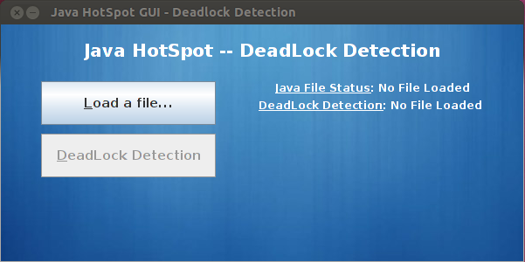
Demonstration

Slide 9
Real-World Deadlocks
Dealing with deadlocks heavily affected the development of operating systems and databases.
Programmers trying to edit the same code
Customers trying to purchase the same product from two or more locations
Trains trying to use the same rail

Slide 10

Summary
Java was written to be able to handle some deadlock detection internally
In order to utilize this functionality, the thread dump must be accessed
Deadlocks are a very real problem that can be diagnosed with different tools that have different strengths and weaknesses

Slide 11

Questions?
One at a time please,
We do not want deadlocking
answers.

